Slide 1
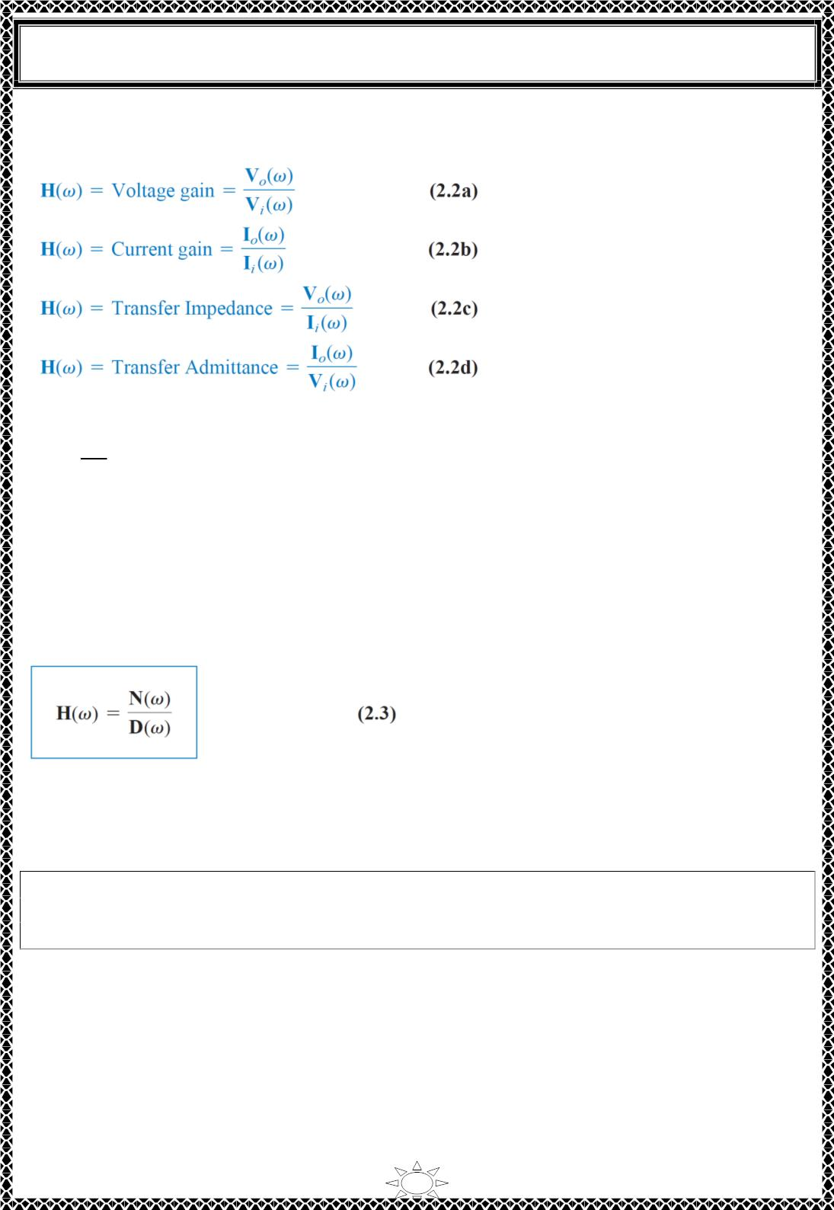
University of Diyala
Engineering College
Electrical Circuits
assuming zero initial conditions. Since the input and output can be either voltage or
current at any place in the circuit, there are four possible transfer functions:
Being a complex quantity, 퐻(휔) has a magnitude 푯(흎) and a phase 흋; that is, 푯(흎) =
푯(흎)/흋.
To obtain the transfer function using Eq. (2.2), we first obtain the frequency‐domain
equivalent of the circuit by replacing resistors, inductors, and capacitors with their
impedances 푹, 풋흎푳, and ퟏ/풋흎푪. We then use any circuit technique (s) to obtain the
appropriate quantity in Eq. (2.2). We can obtain the frequency response of the circuit by
plotting the magnitude and phase of the transfer function as the frequency varies. The
transfer function 푯(흎) can be expressed in terms of its numerator polynomial 푵(흎) and
denominator polynomial 푫(흎) as
Trail Version
Trail Version
Trail Version
Trail Version
Trail Version
Trail Version
Trail Version
Trail Version
Trail Version
Trail Version
Trail Version
Trail Version
Trail Version
The roots of 푵(흎) = ퟎ are called the zeros of 푯(흎) and are usually represented as 풋흎 =
풛 . 풛 . …. Similarly, the roots of 푫(흎) = ퟎ are the poles of 푯(흎) and are represented as
ퟏ
ퟐ
풋흎 = 풑 . 풑 . …
ퟏ
ퟐ
A zero, as a root of the numerator polynomial, is a value that results in a zero
value of the function. A pole, as a root of the denominator polynomial, is a value
for which the function is infinite.
To avoid complex algebra, it is expedient to replace j흎 temporarily with 풔 when working
with 푯(흎) and replace 풔 with j흎 at the end.
2

Slide 2
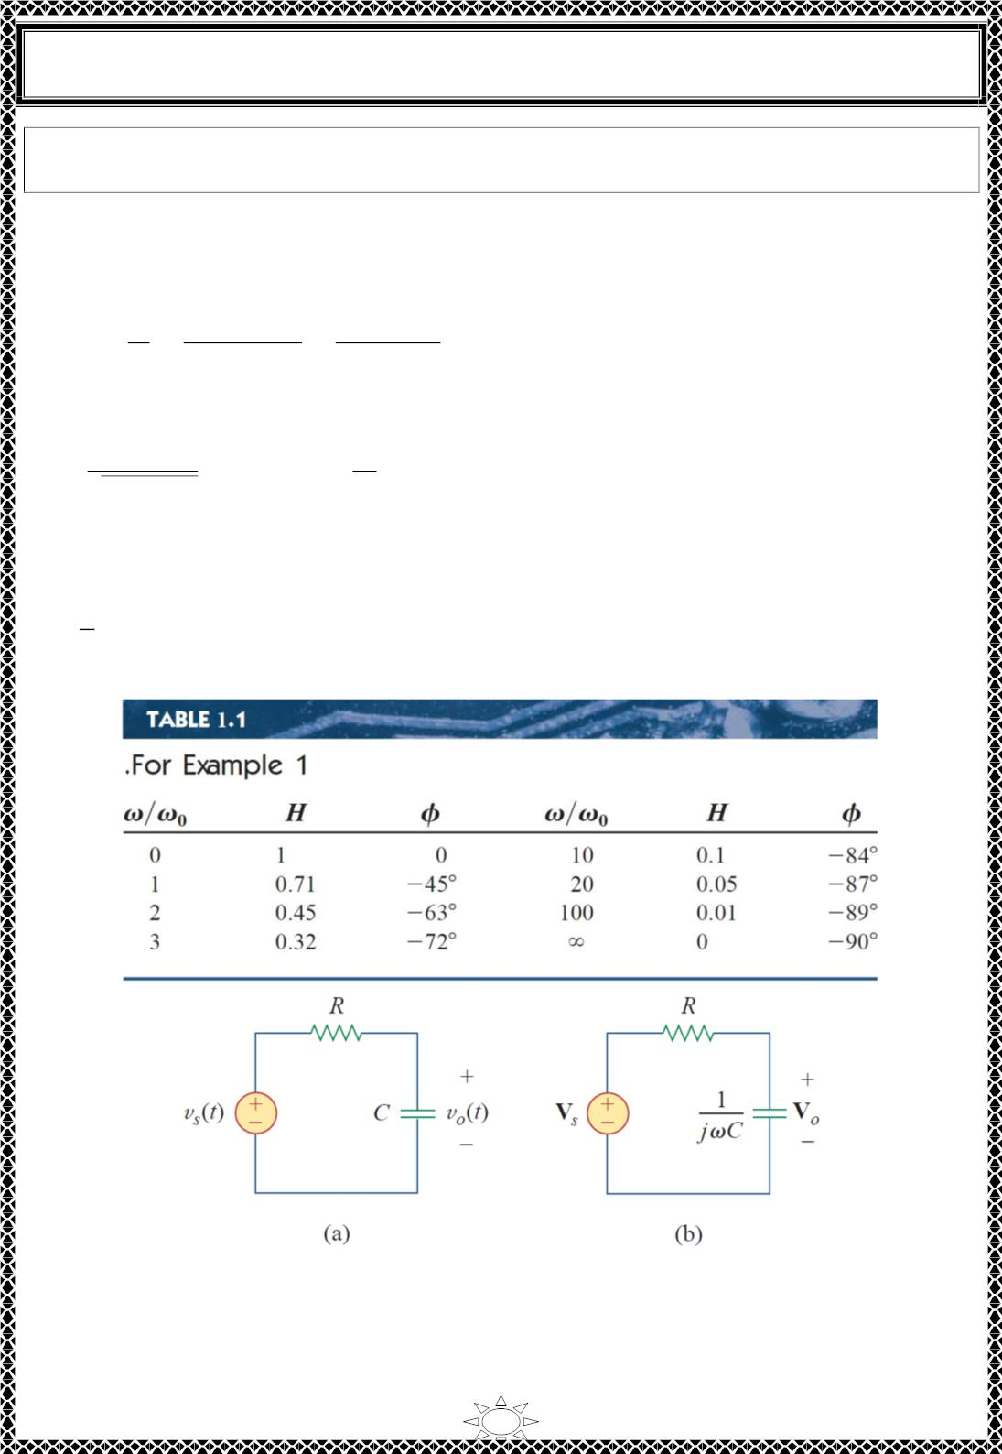
University of Diyala
Engineering College
Electrical Circuits
Example 1: For the 푅퐶 circuit in Fig. 1.1(a), obtain the transfer function 푽 /푽 and its
frequency response. Let 푣 = 푉 푐표ꢀ휔푡.
풐
풔
Solution:
푠
푚
The frequency‐domain equivalent of the circuit is in Fig. 1.1(b). By voltage division, the
transfer function is given by
푉
1/푗휔퐶
1
ꢁ
퐻(휔) =
=
=
푉
푠
푅 + 1/푗휔퐶 1 + 푗휔푅퐶
We obtain the magnitude and phase of 퐻(휔) as
ꢂ
ꢄ
퐻 =
√ꢂꢃ(ꢄ/ꢄ₀)²
, 휑 = −tan^{ꢅꢂ}
ꢄ₀
where 흎_{ퟎ} = ퟏ/푹푪. To plot 푯 and 휑 for ퟎ < 흎 < ∞, we obtain their values at some
critical points and then sketch.
At 흎 = ퟎ. 푯 = ퟏ and 흋 = ퟎ. At 흎 = ∞. 푯 = ퟎ and 흋 = −ퟗퟎ^{풐.} Also, at
흎 = 흎_{ퟎ}. 푯 =
ퟏ/ꢆퟐ and 흋 = −ퟒퟓ^{풐}. With these and a few more points as shown in Table 1.1, we find
that the frequency response is as shown in Fig. 1.2.
Trail Version
Trail Version
Trail Version
Trail Version
Trail Version
Trail Version
Trail Version
Trail Version
Trail Version
Trail Version
Trail Version
Trail Version
Trail Version
Fig. 1.1 (a) time-domain RC circuit, (b) frequency-domain RC circuit.
3

Slide 3
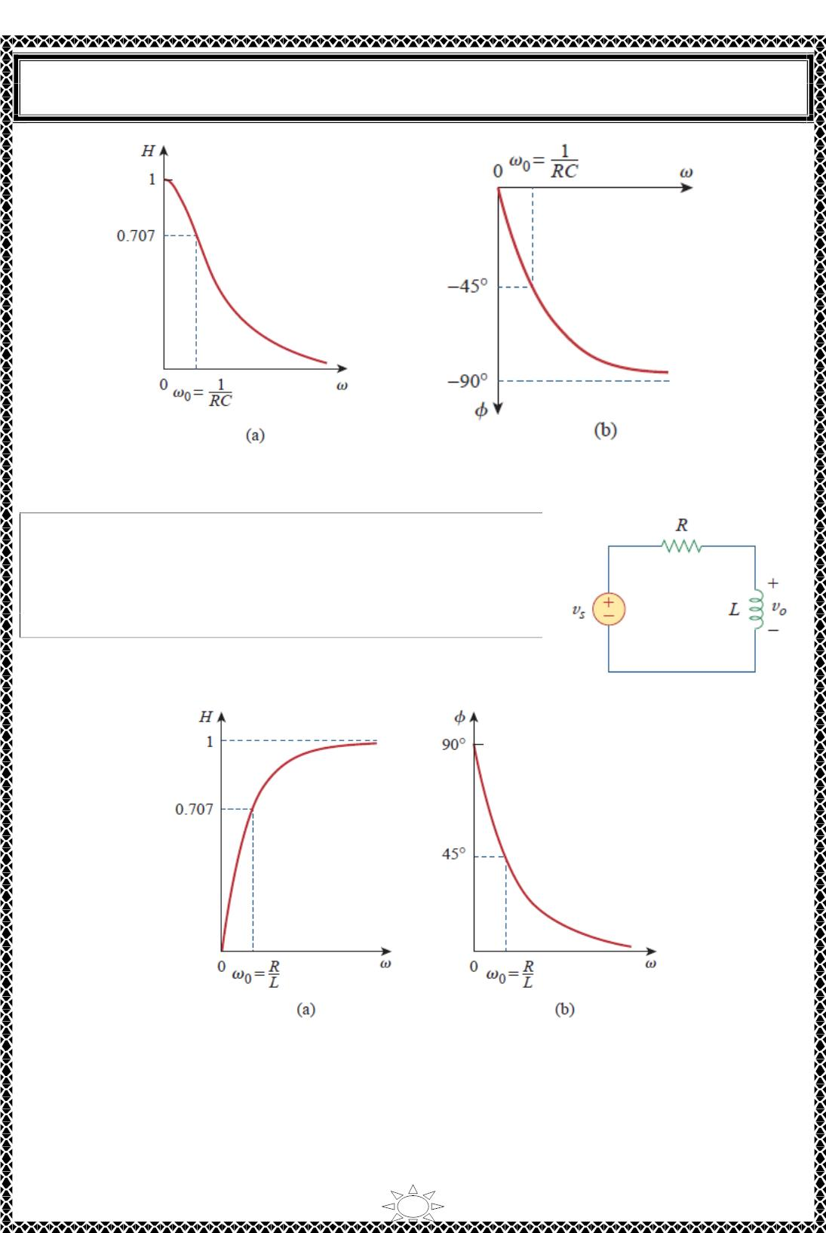
University of Diyala
Engineering College
Electrical Circuits
Fig. 1.2 Frequency response of the RC circuit: (a) amplitude response, (b) phase response.
H.W.1: Obtain the transfer function 푉 /푉 of the 푅퐿 circuit
표
푠
in Fig. 1.1, assuming 푣 = 푉 푐ꢀꢁ휔푡.. Sketch its frequency
response.
푠
푚
Trail Version
Trail Version
Trail Version
Trail Version
Trail Version
Trail Version
Trail Version
Trail Version
Trail Version
Trail Version
Trail Version
Trail Version
Trail Version
Answer: 풋흎푳/(푹 + 풋흎푳), see Fig. 1.2 for the response.
Fig. 1.2 Frequency response of the RL circuit in Fig. 1.1.
4

Slide 4
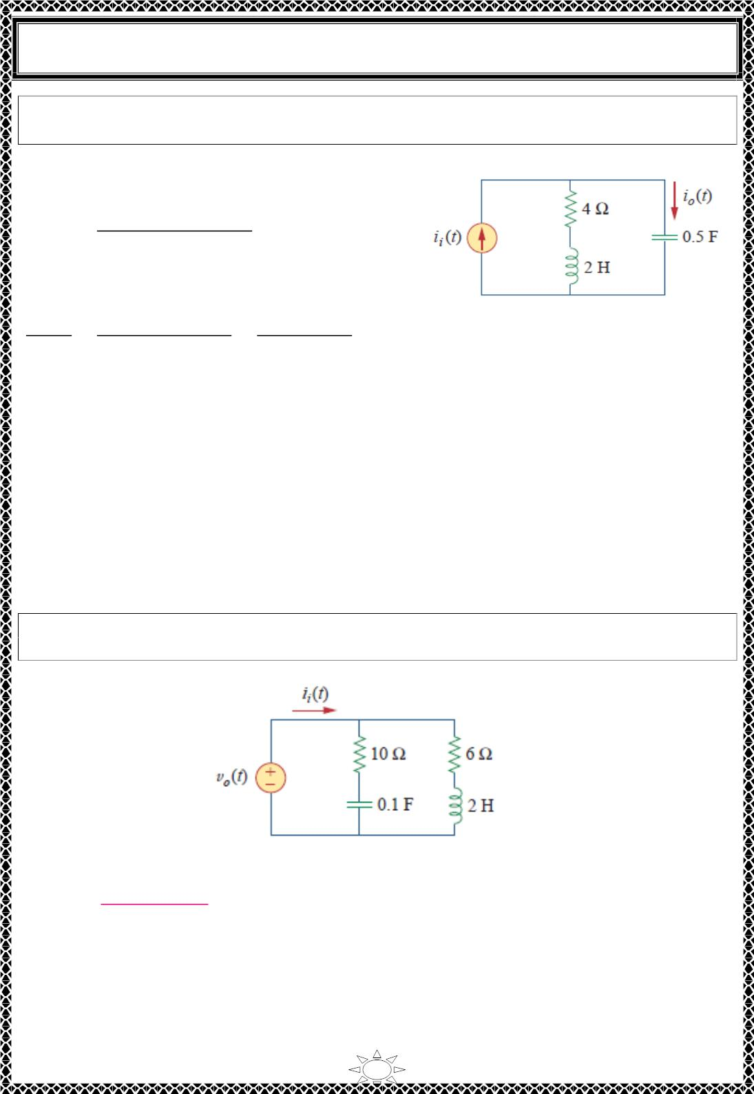
University of Diyala
Engineering College
Electrical Circuits
Example 2: For the circuit in Fig. 2.1, calculate the gain 푰 (흎)/푰 (흎) and its poles and
zeros.
풐
풔
Solution:
By current division,
퐼_{표}(휔) =
4 + 푗2휔
4 + 푗2휔 + 1/푗0.5휔
퐼_{푖}(휔)
or
퐼_{표}(휔) 푗0.5휔(4 + 푗2휔)
퐼_{푖}(휔) 1 + 푗2휔 + (푗휔)ꢀ 푠ꢀ + 2푠 + 1
=
=
푠(푠 + 2)
, 푠 = 푗휔
Fig. 2 ∙ 1
The zeros are at
푠(푠 + 2) = 0 ⇒ 푧 = 0, 푧 = −2
ꢁ
ꢀ
The poles are at
푠ꢀ + 2푠 + 1 = (푠 + 1)ꢀ = 0
Thus, there is a repeated pole (or double pole) at 푝 = −1.
Trail Version
Trail Version
Trail Version
Trail Version
Trail Version
Trail Version
Trail Version
Trail Version
Trail Version
Trail Version
Trail Version
Trail Version
Trail Version
H.W.2: Find the transfer function 푉 (휔)/퐼 (휔) for the circuit shown below. Obtain its
zeros and poles.
표
푖
Answer:
ퟏퟎ(풔ꢂퟏ)(풔ꢂퟑ)
, 풔 = 풋흎; zeros: −ퟏ, −ퟑ; poles: −ퟎ. ퟔퟖퟑ, −ퟕ. ퟑퟏퟕ
풔^{ퟐ}ꢂퟖ풔ꢂퟓ
5

Slide 5
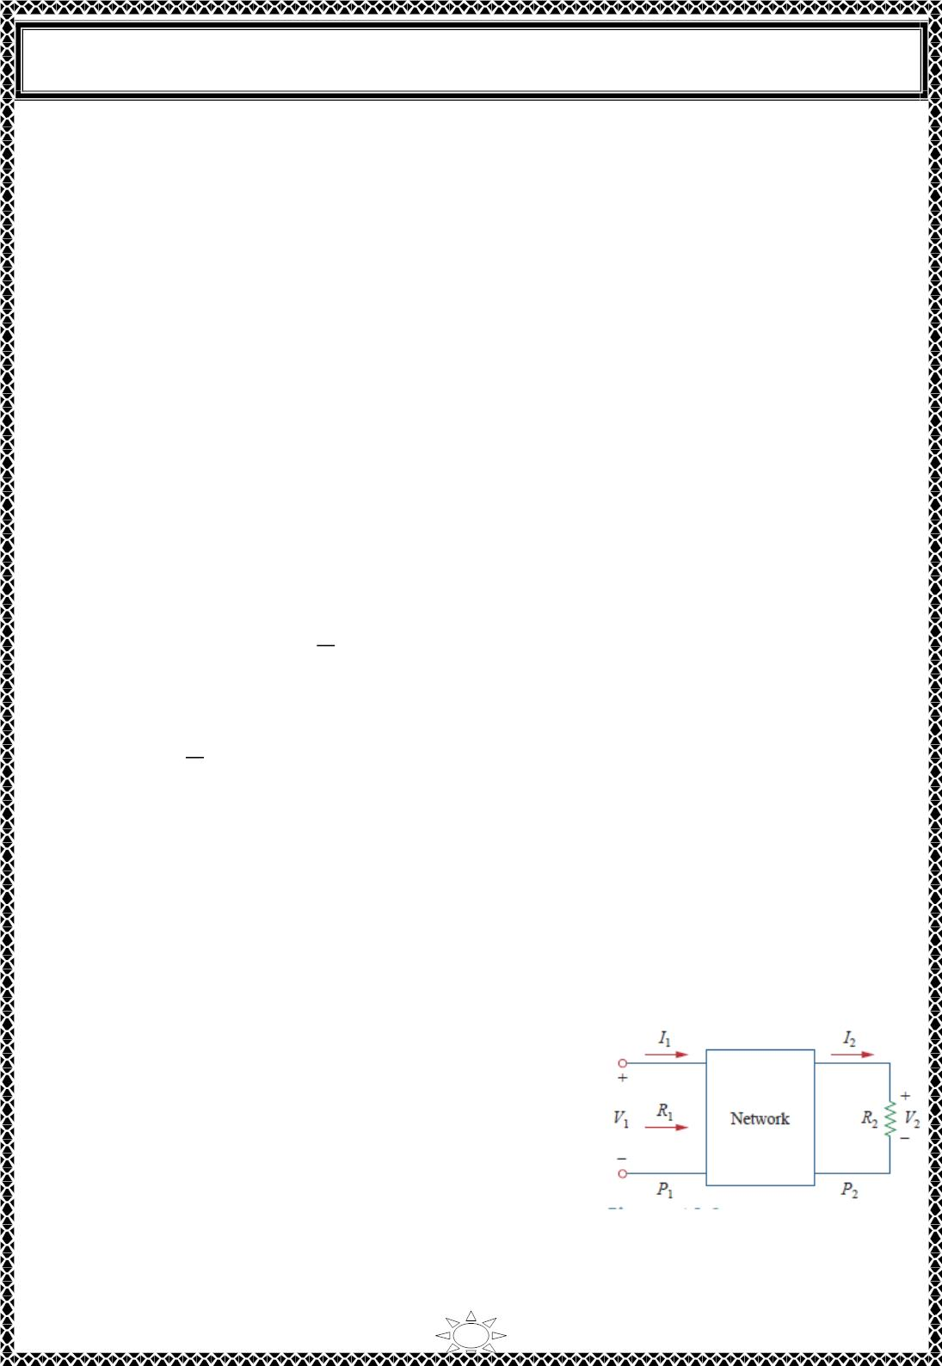
University of Diyala
Engineering College
Electrical Circuits
3) Decibel Scale
It is not always easy to get a quick plot of the magnitude and phase of the transfer function
as did above. A more systematic way of obtaining the frequency response is to use Bode
plots. Before begin to construct Bode plots, it should take care of two important issues: the
use of logarithms and decibels in expressing gain.
Since Bode plots are based on logarithms, it is important to keep the following properties
of logarithms in mind:
1. log 푃 푃 = log 푃 + log 푃
2
1
2
1
2. log 푃 /푃 = log 푃 − log 푃
2
1
2
1
_{3. log 푃}^{푛} = ꢀ log 푃
4. log ꢁ = 0
In communications systems, gain is measured in bels. Historically, the bel is used to
measure the ratio of two levels of power or power gain 푮; that is,
Trail Version
Trail Version
Trail Version
Trail Version
Trail Version
Trail Version
Trail Version
Trail Version
Trail Version
Trail Version
Trail Version
Trail Version
Trail Version
^{ꢃ}ꢄ
ꢃ_{ꢅ}
퐺 = Number of bels = log_{1ꢂ}
…(3.1)
The decibel (풅푩) provides us with a unit of less magnitude. It is 1/l0th of a bel & given by
^{ꢃ}ꢄ
ꢃ_{ꢅ}
퐺_{푑퐵} = ꢁ0log_{1ꢂ}
…(3.2)
When 푃 = 푃 , there is no change in power and the gain is 0ꢆꢇ. If 푃 = ꢈ푃 , the gain is,
1
2
2
1
퐺_{푑퐵} = ꢁ0log_{1ꢂ}ꢈ = 3ꢆꢇ
…(3.3)
and when 푃 = 0.5푃 , the gain is
2
1
퐺_{푑퐵} = ꢁ0log_{1ꢂ}0 ∙ 5 = −3ꢆꢇ
…(3.4)
Equations (3.3) and (3.4) show another reason why logarithms are greatly used: The
logarithm of the reciprocal of a quantity is simply
negative the logarithm of that quantity. Alternatively, the
gain 퐺 can be expressed in terms of voltage or current
ratio. To do so, consider the network shown in Fig. 3.1.
If 푃 is the input power, 푃 is the output (load) power, 푅
1
2
1
is the input resistance, and 푅 is the load resistance, then
2
푃 = 0.5푉²/푅 and 푃 = 0.5푉²/푅 , and Eq. (3.2)
becomes,
1
1
1
2
2
2
Fig. 3.1 Voltage-current relationships
for a four terminal network.
6

Slide 6

University of Diyala
Engineering College
Electrical Circuits
^{푃}2
푃_{ꢂ}
2
푉 /푅
푉
^{푅}ꢂ
푅₂
2
)^{ꢃ} + 10logꢀꢁ
2
2
퐺_{푑퐵} = 10logꢀꢁ = 10logꢀꢁ
= 10logꢀꢁ(
…(3.5)
…(3.6)
2
푉 /푅
ꢂ
푉
ꢂ
ꢂ
푉
2
푉
ꢂ
^{푅}ꢂ
푅_{ꢂ}
퐺_{푑퐵} = ꢄ0logꢀꢁ
− 10logꢀꢁ
For the case when ꢅ = ꢅ , a condition that is often assumed when comparing voltage
ꢃ
ꢀ
levels, Eq. (3.6) becomes
푉
2
퐺_{푑퐵} = ꢄ0logꢀꢁ
…(3.7)
푉
ꢂ
^{ꢃ}ꢅ
ꢆ = 퐼^{ꢃ}ꢅ
Instead, if ꢆꢀ = 퐼ꢀ and
_{ꢃ}, for
ꢅ = ꢅ_{ꢃ}, obtain
ꢀ
ꢀ
ꢃ
ꢃ
^{ꢇ}2
퐺_{푑퐵} = ꢄ0logꢀꢁ
(3.8)
^{ꢇ}ꢂ
Three things are important to note from Eqs. (3.2), (3.7), and (3.8):
1. That 10log is used for power, while ꢄ0log is used for voltage or current, because of
ꢀꢁ
ꢀꢁ
the square relationship between them
(ꢆ = ꢈ^{ꢃ}/ꢅ = 퐼^{ꢃ}ꢅ) .
Trail Version
Trail Version
Trail Version
Trail Version
Trail Version
Trail Version
Trail Version
Trail Version
Trail Version
Trail Version
Trail Version
Trail Version
Trail Version
2. That the ꢉꢊ value is a logarithmic measurement ofthe ratio of one variable to another of
the same type. Therefore, it applies in expressing the transfer function 퐻 in Eqs. (2.2a) and
(2.2b), which are dimensionless quantities, but not in expressing 퐻 in Eqs. (2.2c) and
(2.2d).
3. It is important to note that, only use voltage and current magnitudes in Eqs. (3.7) and
(3.8). Negative signs and angles will be handled independently.
7

Slide 7

University of Diyala
Engineering College
Electrical Circuits
4) Bode Plots
Obtaining the frequency response from the transfer function is an uphill task. The
frequency range required in frequency response is often so wide that it is inconvenient to
use a linear scale for the frequency axis. Also, there is a more systematic way of locating
the important features of the magnitude and phase plots of the transfer function. For these
reasons, it has become standard practice to plot the transfer function on a pair of
semilogarithmic plots: the magnitude in decibels is plotted against the logarithm of the
frequency; on a separate plot, the phase in degrees is plotted against the logarithm of the
frequency. Such semilogarithmic plots of the transfer function—known as Bode plots—
have become the industry standard.
Bode plots are semilog plots of the magnitude (in decibels) and phase (in
degrees) of a transfer function versus frequency.
Bode plots contain the same information as the nonlogarithmic plots discussed in the
previous section.
The transfer function can be written as
Trail Version
Trail Version
Trail Version
Trail Version
Trail Version
Trail Version
Trail Version
Trail Version
Trail Version
Trail Version
Trail Version
Trail Version
Trail Version
퐻 = 퐻/휑 = 퐻푒^{푗ꢀ}
…(4.1)
Taking the natural logarithm of both sides,
푙푛 퐻 = In 퐻 + 푙푛푒^{푗ꢀ} = 푙푛퐻 + ꢁ휑
…(4.2)
Thus, the real part of 푙푛퐻 is a function of the magnitude while the imaginary part is the
phase. In a Bode magnitude plot, the gain
퐻 = 20log 퐻
…(4.3)
푑퐵
1ꢂ
is plotted in decibels (ꢃꢄ) versus frequency.
In a Bode phase plot, 휑 is plotted in degrees versus frequency. Both magnitude and phase
plots are made on semilog graph paper.
A transfer function in the form of Eq. (2.3) may be written in terms of factors that have
real and imaginary parts. One such representation might be,
±ꢆ
ꢉ
퐾(푗ꢅ) (1ꢇ푗ꢅ/푧 )[1ꢇ푗ꢈ휁 ꢅ/ꢅ ꢇ(푗ꢅ/ꢅ ) ]
퐻(휔) =
ꢆ
ꢆ
푘
ꢉ
푘
…(4.4)
(1ꢇ푗ꢅ/푝 )[1ꢇ푗ꢈ휁 ꢅ/ꢅ ꢇ(푗ꢅ/ꢅ ) ]
ꢆ
ꢉ
ꢊ
ꢊ
8

Slide 8
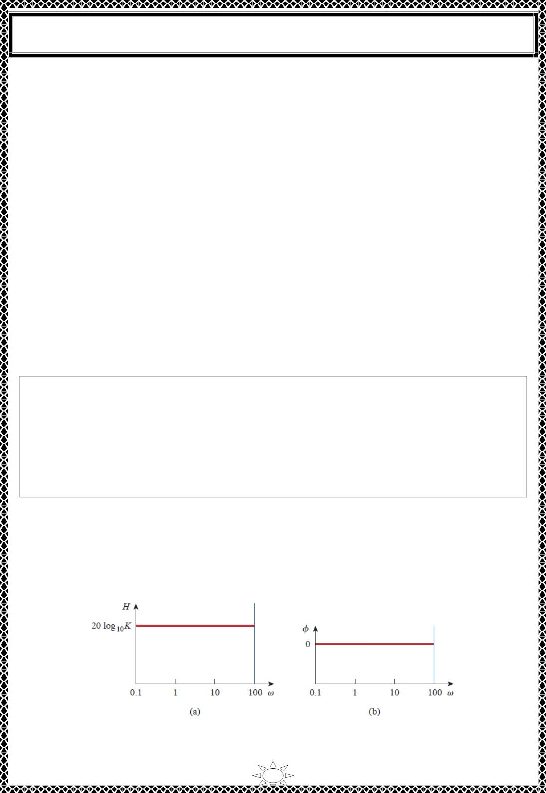
University of Diyala
Engineering College
Electrical Circuits
which is obtained by dividing out the poles and zeros in 퐻(휔) . The representation of
퐻(휔) as in Eq. (4.4) is called the standard form. 퐻(휔) may include up to seven types of
different factors that can appear in various combinations in a transfer function. These are:
1. A gain 퐾.
2. A pole (푗휔)⁻¹ or zero
(푗휔) at the origin.
3. A simple pole ꢀ/(ꢀ + 푗휔/푝 ) or zero (ꢀ + 푗휔/푧 )
1
1
4. A quadratic pole ꢀ/[ꢀ + 퐽2휁 휔/휔 + (푗휔/휔 )ꢁ] or zero
[ꢀ + 푗2휁 휔/휔 + (푗휔/휔 )ꢁ]
ꢁ
푛
푛
1
푘
푘
In constructing a Bode plot, we plot each factor separately and then add them graphically.
The factors can be considered one at a time and then combined additively because of the
logarithms involved. It is this mathematical convenience of the logarithm that makes Bode
plots a powerful engineering tool. We will now make straight‐line plots of the factors
listed above. We shall find that these straight‐line plots known as Bode plots approximate
the actual plots to a reasonable degree of accuracy.
Trail Version
Trail Version
Trail Version
Trail Version
Trail Version
Trail Version
Trail Version
Trail Version
Trail Version
Trail Version
Trail Version
Trail Version
Trail Version
Notes:
1) The origin is where 휔 = 1 or log휔 = 0 and the gain is zero.
2) A decade is an interval between two frequencies with a ratio of 10; e.g., between
휔 and 10휔 , or between 10 and 100 Hz. Thus, 20 dB/decade means that the
ꢂ
ꢂ
magnitude changes 20 dB whenever the frequency changes tenfold or one decade.
표
Constant term: For the gain 퐾, the magnitude is 20log 퐾 and the phase is 0 ; both are
1ꢂ
constant with frequency. Thus, the magnitude and phase plots of the gain are shown in Fig.
4.1. If 퐾 is negative, the magnitude remains 20log_{1ꢂ}|퐾| but the phase is ±ꢀ80^{표.}
Fig. 4.1. Bode plots for gain K: (a) magnitude plot, (b) phase plot.
9

Slide 9
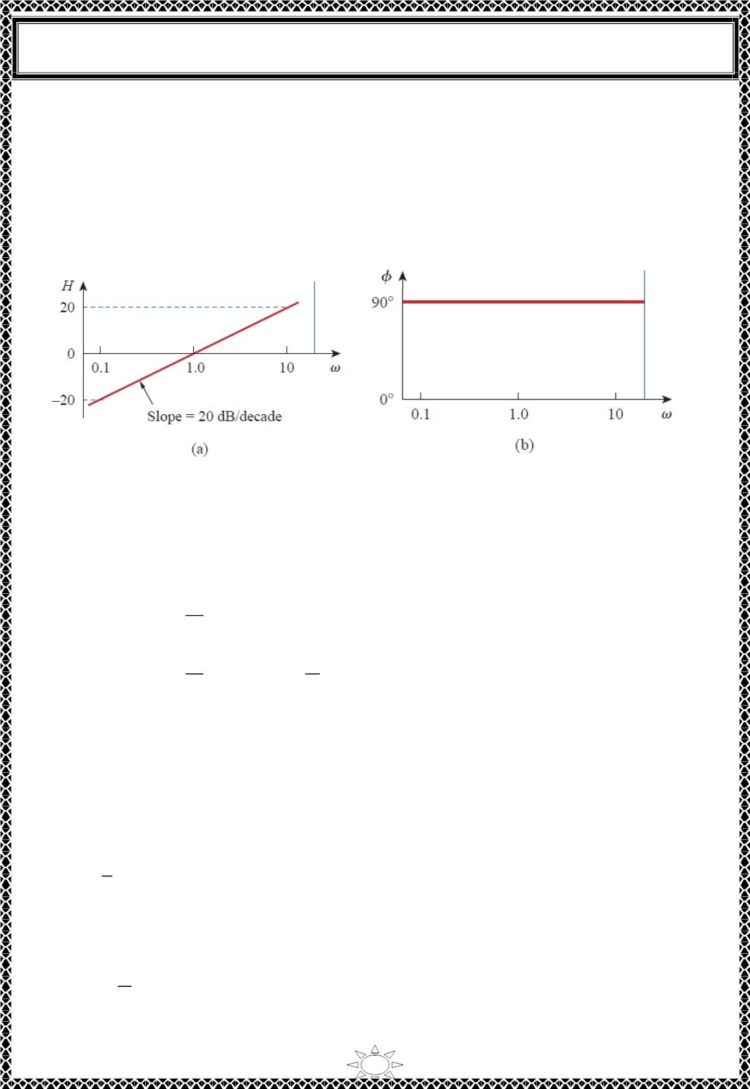
University of Diyala
Engineering College
Electrical Circuits
푷풐풍풆/zero at the origin: For the zero (푗휔) at the origin, the magnitude is 20log_{1ꢀ}휔 and
the phase is is 90⁰. These are plotted in Fig. 4.2, where we notice that the slope of the
magnitude plot is 20 dB/decade, while the phase is constant with frequency. The Bode
plots for the pole (푗휔)⁻¹ are similar except that the slope of the magnitude plot is
ꢁ20푑퐵/decade while the phase is ꢁ90^{표}. In general, for (푗휔)^{푁} , where ꢂ is an integer, the
magnitude plot will have a slope of 20ꢂ푑퐵/decade, while the phase is 90ꢂ degrees.
Fig. 4.2. Bode plots for a zero (푗휔) at the origin: (a) magnitude plot, (b) phase plot.
Simple 풑풐풍풆/풛풆풓풐: For the simple zero (ꢃ + 푗휔/푧 ) , the magnitude is 20log |ꢃ +
Trail Version
Trail Version
Trail Version
Trail Version
Trail Version
Trail Version
Trail Version
Trail Version
Trail Version
Trail Version
Trail Version
Trail Version
Trail Version
1
1ꢀ
푗휔/푧 | and the phase is tan⁻¹휔/푧 . We notice that ,
1
1
ꢆꢇ
퐻_{ꢄꢅ} = 20log_{1ꢀ}|ꢃ + | ⇒ 20log_{1ꢀ}ꢃ = 0
…(4.5)
…(4.6)
ꢈ_{ꢉ}
as 휔 → 0
ꢆꢇ
ꢇ
퐻_{ꢄꢅ} = 20log_{1ꢀ}|ꢃ + | ⇒ 20log_{1ꢀ}
푍_{ꢉ}
푍
ꢉ
as 휔 → ∞
showing that we can approximate the magnitude as zero (a straight line with zero slope)
for small values of 휔 and by a straight line with slope 20 푑퐵/decade for large values of 휔.
The frequency 휔 = 푧₁ where the two asymptotic lines meet is called the corner frequency or
break frequency. Thus the approximate magnitude plot is shown in Fig. 4.3(a), where the
actual plot is also shown. Notice that the approximate plot is close to the actual plot except
at the break frequency, where 휔 = 푧 and the deviation is 20log |(ꢃ + 푗ꢃ)| =
20log_{1ꢀ}√2 ≅ 3푑퐵.
1
1ꢀ
The phase tan
⁻¹(휔/푧 )
can be expressed as
1
ꢇ
0
휔 = 0
휑 = tan⁻¹( ) = {45^{표} 휔 = 푧₁
…(4.7)
ꢈ
ꢉ
90^{표} 휔 → ∞
10

Slide 10
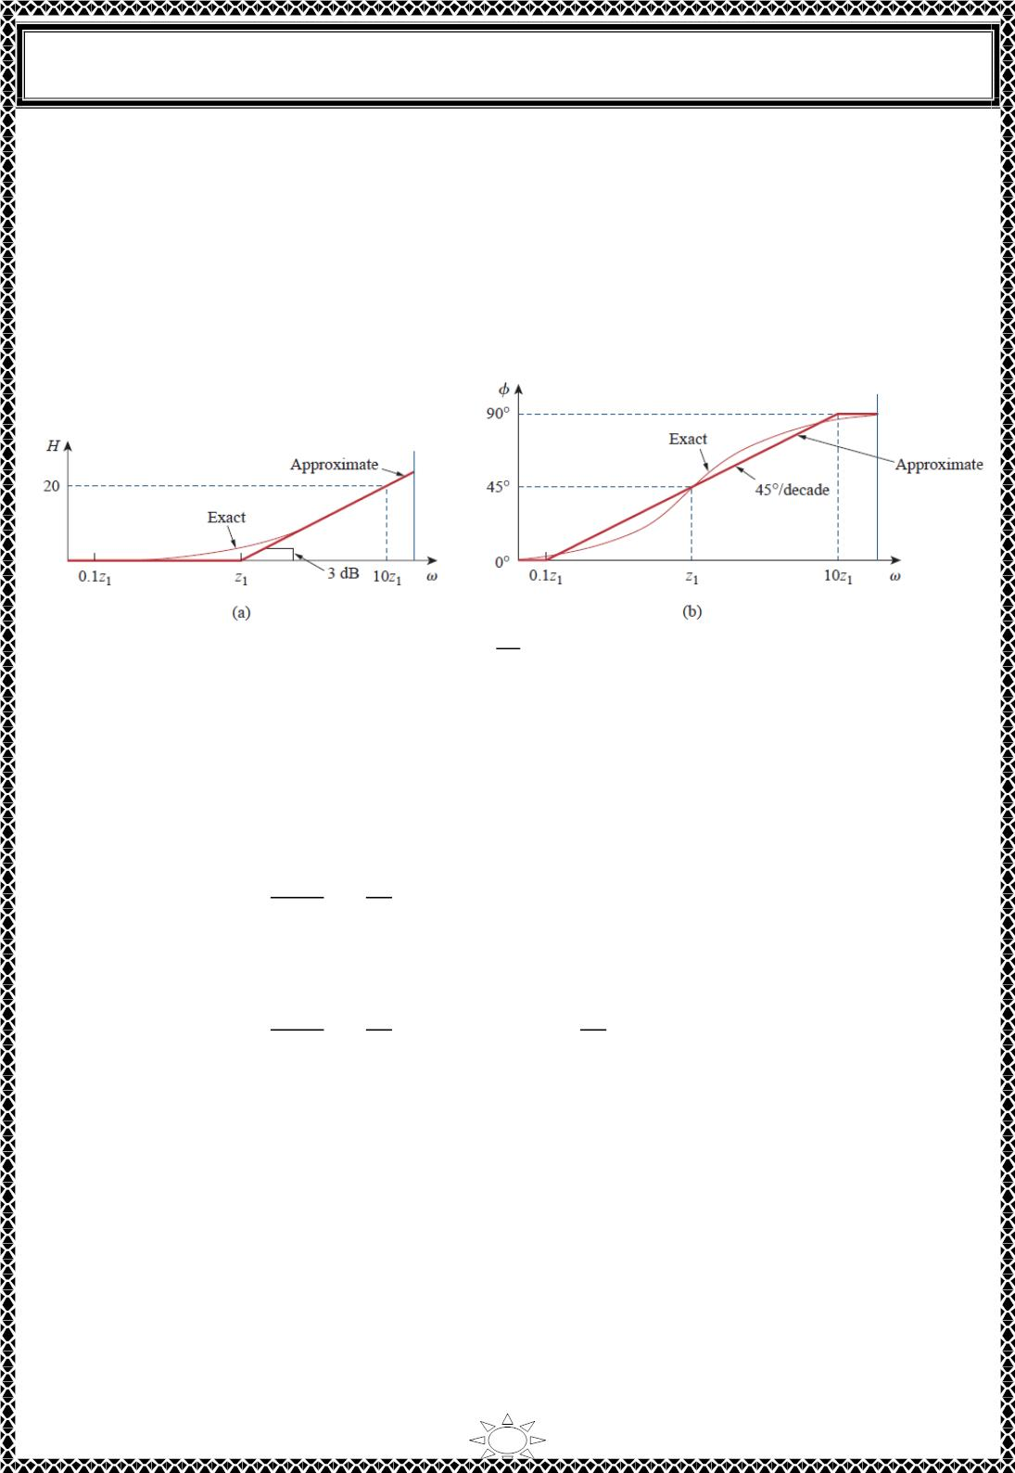
University of Diyala
Engineering College
Electrical Circuits
표
As a straight‐line approximation, let 휑 ≅ 0 for 휔 ≤ 푧 /ꢀ0, 휑 ≅ 45 for
휔 = 푧₁, and
휑 =
1
90^{표} for 휔 ≥ ꢀ0푧₁. As shown in Fig. 4.3 (b) along with the actual plot, the straight‐line
plot has a slope of 45^{표} per decade.
The Bode plots for the pole ꢀ/(ꢀ + 푗휔/푝₁) are similar to those in Fig. 4.3 except that the
corner frequency is at 휔 = 푝₁, the magnitude has a slope of −20 푑퐵/decade, and the phase
has a slope ꢁ푓 − 45^{표} per decade.
ꢂꢃ
Fig. 4.3. Bode plots for a zero (ꢀ + ): (a) magnitude plot, (b) phase plot.
ꢄ_{ꢅ}
Trail Version
Trail Version
Trail Version
Trail Version
Trail Version
Trail Version
Trail Version
Trail Version
Trail Version
Trail Version
Trail Version
Trail Version
Trail Version
Quadratic 풑풐풍풆/풛풆풓풐: The magnitude of the quadratic pole ꢀ/[ꢀ + 푗2휁 휔/휔 +
ꢆ
푛
(푗휔/휔 )^{ꢆ}] is −20log |ꢀ + 푗2휁 휔/휔 + (푗휔/휔 )^{ꢆ}| and the phase is −tan^{ꢈ1}(2휁 휔/
푛
1ꢇ
ꢆ
푛
푛
ꢆ
휔 )/(ꢀ − 휔^{ꢆ}/휔^{ꢆ}) . But
푛
푛
^{ꢂꢆꢋ}ꢌ^{ꢃ}
ꢃ_{ꢍ}
ꢂꢃ
퐻_{ꢉꢊ} = −20log_{1ꢇ}|ꢀ +
+ ( )^{ꢆ}| ⇒ 0
…(4.8)
ꢃ
ꢍ
as 휔 → 0
and
^{ꢂꢆꢋ}ꢌ^{ꢃ}
ꢃ_{ꢍ}
ꢂꢃ
ꢃ
퐻_{ꢉꢊ} = −20log_{1ꢇ}|ꢀ +
+ ( )^{ꢆ}| ⇒ −40log
…(4.9)
ꢃ
ꢍ
1ꢇ
ꢃ
ꢍ
as 휔 → ∞
Thus, the amplitude plot consists of two straight asymptotic lines: one with zero slope for
휔 < 휔 and the other with slope −40푑퐵/ decade for 휔 > 휔 , with 휔 as the corner
푛
푛
푛
frequency. Fig. 4.4(a) shows the approximate and actual amplitude plots. Note that the
actual plot depends on the damping factor 휁 as well as the corner frequency 휔 . The
ꢆ
푛
significant peaking in the neighborhood of the corner frequency should be added to the
straight‐line approximation if a high level of accuracy is desired. However, we will use the
straight‐line approximation for the sake of simplicity.
11

